Slide 1

Confronting the House
An African American History Lesson

Slide 2

Objective
When you leave here today, we will be able to:
Compare and contrast key claims made by Black intellectuals about American democracy and justice.
Explain how the metaphor of a house/home can be used to describe the history of the United States.

Slide 3
Think Write Share
01.
Think Write Share: When you read the words “American Exceptionalism,” what comes to mind?
Think Write Share: What is the difference between a house and a home?
02.

Slide 4
Important Vocabulary
American Exceptionalism
Democracy
Hypocrisy
Agency
the belief that the United States is special/unique due to being a role-model country of freedom and democracy
government
“rule by the people,” where citizens elect representatives to make decisions regarding laws and policies
having a moral or value, but then acting/behaving against it
individuals and groups exerting power and making free choices

Slide 5
Further Thoughts on American Exceptionalism
“American exceptionalism, idea that the United States of America is a unique and even morally superior country for historical, ideological, or religious reasons.” —Britannica
The concept of American exceptionalism has provided US citizens with a representative form of self-recognition across the centuries. John Winthrop’s admonition to his fellow New England colonists is usually cited as the foundational moment of American exceptionalism: “We shall be as a city upon a hill. The eyes of all people are upon us.” —Oxford Bibliography

Slide 6
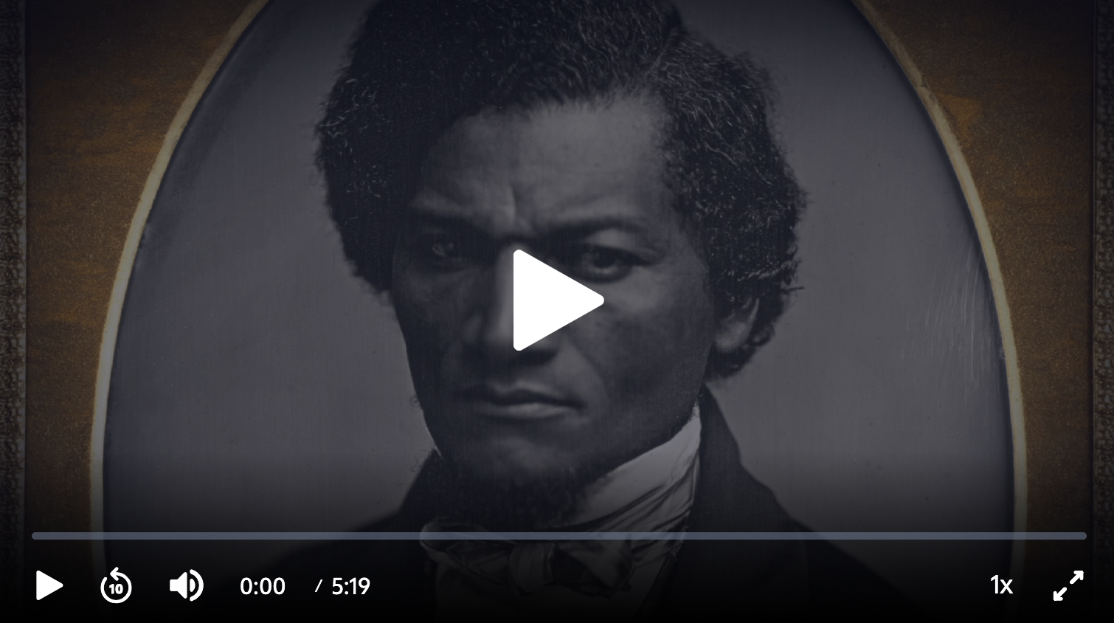
PBS Video: Frederick Douglass |
The African Americans

Slide 7
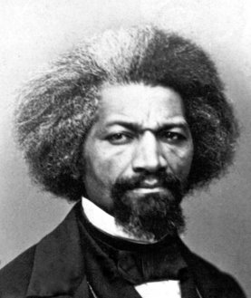
Frederick Douglass: Read to Understand
What does Douglass say about the Fourth of July?
What does he point out about the United States?

Slide 8
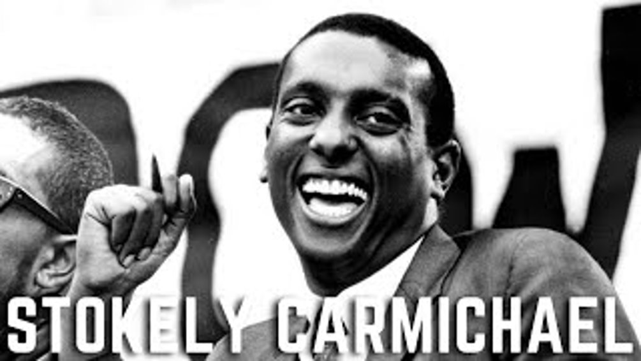
Option 1 (Video): Background Information on Stokely Carmichael

Slide 9
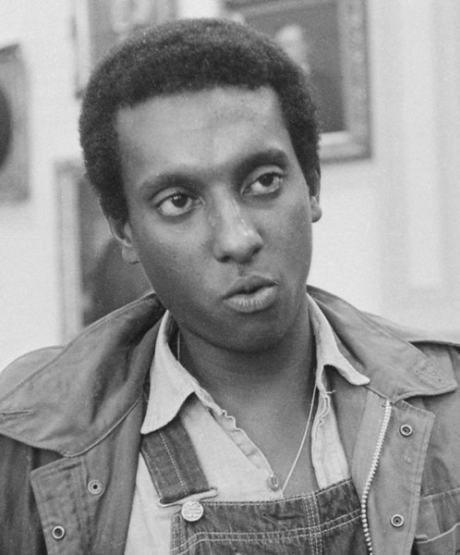
Option 2:
Mini Lecture
Born in Trinidad, moved to New York City as a toddler
Went to Howard University, majored in philosophy
Joined SNCC and participated in Freedom Rides
Worked to register Black voters
Activism continued; became known for “Black Power”
Changed his name to Kwame Toure

Slide 10
Stokely Carmichael: Read to Understand
What does Carmichael say about freedom?
What does he say about civil rights bills?

Slide 11
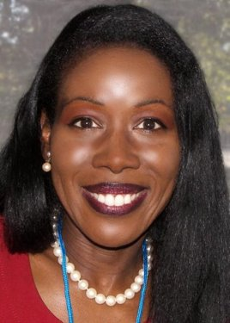
Isabel Wilkerson:
Mini Lecture
African American journalist
First African American to win Pulitzer Prize for journalism
Known for two books
  Warmth of Other Suns about the Great Migration
  Caste about racial hierarchy

Slide 12
Isabel Wilkerson:
Read to Understand
How does Wilkerson use the metaphor of a house to describe the history of the United States?

Slide 13
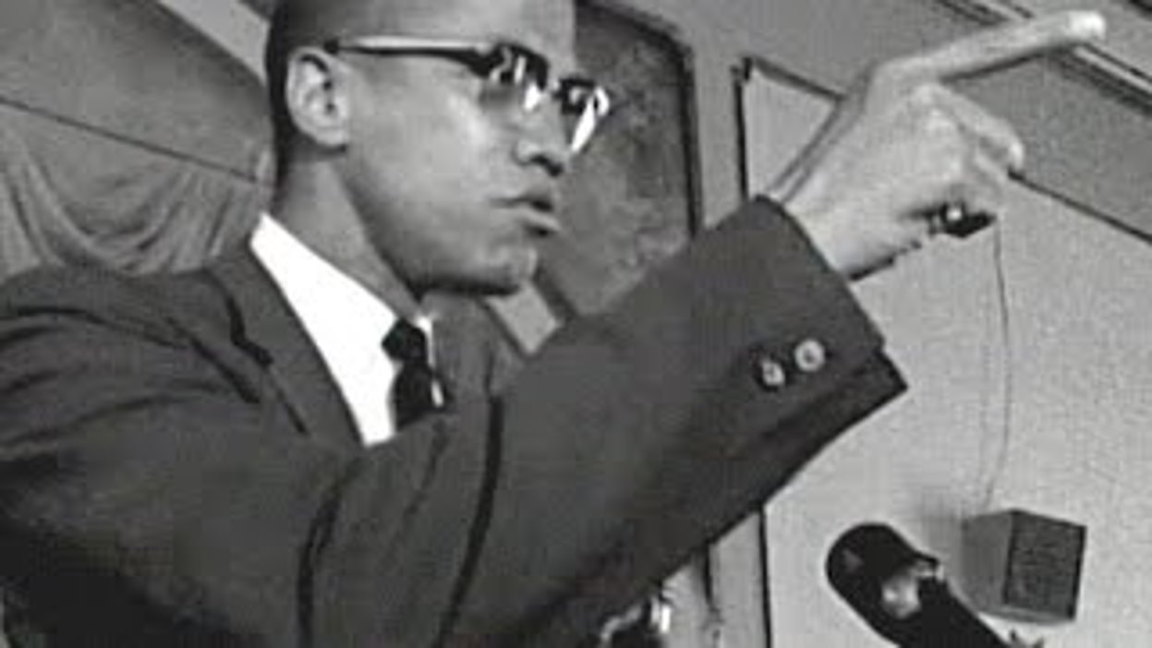
Malcolm X (Video 1): Watch to Understand
What does Malcolm X want Black people to do about oppression?
In your own words, what is Malcolm X trying to say about “hate”?
What does he say about America’s house?

Slide 14
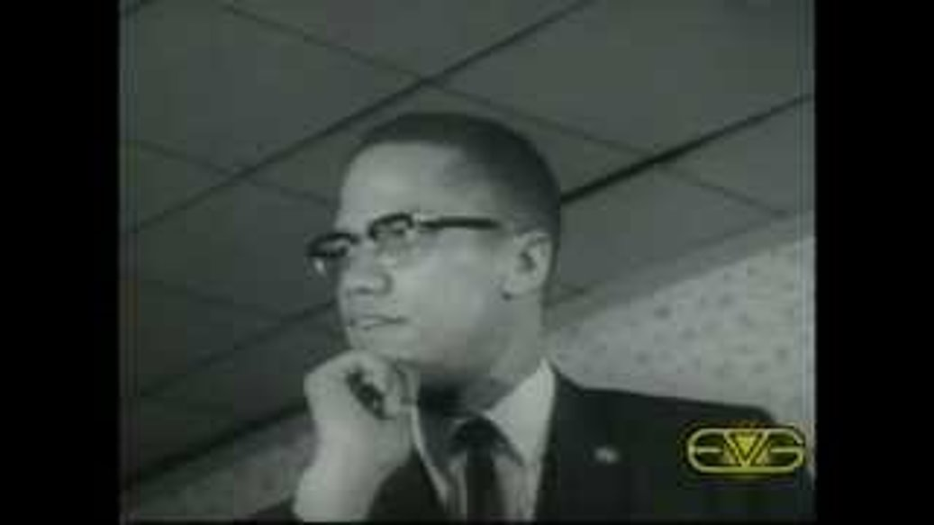
Malcolm X (Video 2): Watch to Understand
What does Malcolm X say about police brutality?
What evidence does he provide that Black people rarely get justice in the legal system?
Why does he believe America’s democracy is a hypocrisy?

Slide 15

Toni Morrison: Interesting Facts (Video)

Slide 16
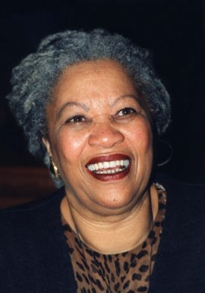
Toni Morrison:
Read to Understand
What does Morrison want to do to the house?
How does Morrison relate house to home?
What does Morrison say about race?

Slide 17
Exit Ticket
01.
What should be done with America’s “house”? In your response, cite evidence from one of the sources used today.
What role does justice play in rebuilding America’s house? In your response, cite evidence from one of the sources used today.
02.

Slide 18
Thank You

