Slide 1

Fieldwork vs. Housework Lesson
Author: Abigail Henry
Notes:
Video URL: https://player.vimeo.com/external/372311827.hd.mp4?s=123d85871c478ae56caebd12cc6da83ac9a9d976&oauth2_token_id=57447761

Slide 2

Success Criteria & Big Questions
Success Criteria
Students will compare and contrast the role and advantages of fieldwork vs. housework.
Students will evaluate the complexity of the division in fieldwork vs. housework.
“Big” Questions
Why is there so much complexity in the history of fieldwork vs. housework?
Do you agree with Malcolm X’s assertion about the “field” and “house” negro?

Slide 3
Racial Vocabulary
NO
slave
master
fugitive
race riot
plantation
YES
enslaved person (African)
enslaver/ owner
freedom seeker
racialized terrorism/ massacre
labor camp
Notes:
Remind Students about the importance of language. It is important to point out that some historians prefer the use of the word labor camp to highlight forced work on the location. A balance for this is using the words "house work" and "field work" as opposed to "field slave" and "house slave."

Slide 4

The Process of Enslavement
What was the impact of slavery? How did Black people show resilience?
Fieldwork
Housework
Middle Passage
March to Coast
factories
Conditioning
Skilled work
Urban work
Industrial work
Notes:
Use to review as a recap of the process of enslavement

Slide 5
Think, Write, Share
What do you think the person who worked inside of the house may have said about the person who worked outside of the house?
What do you think the person who worked outside of the house may have said about the person who worked inside of the house?

Slide 6
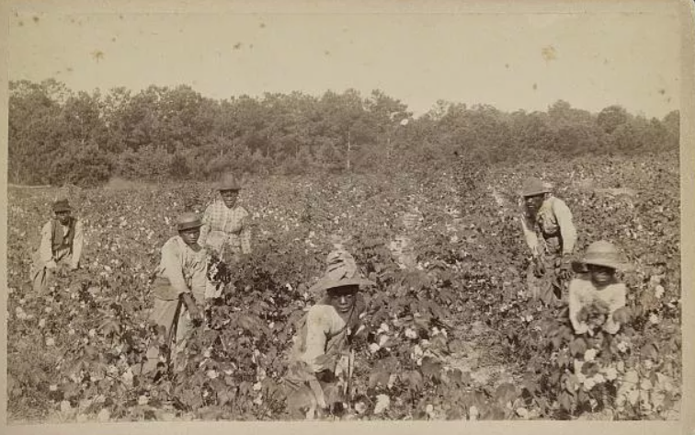
Discuss
What might someone who was forced to work in the field have had to worry about?
Library of Congress Prints and Photographs Division, 2015650292.

Slide 7
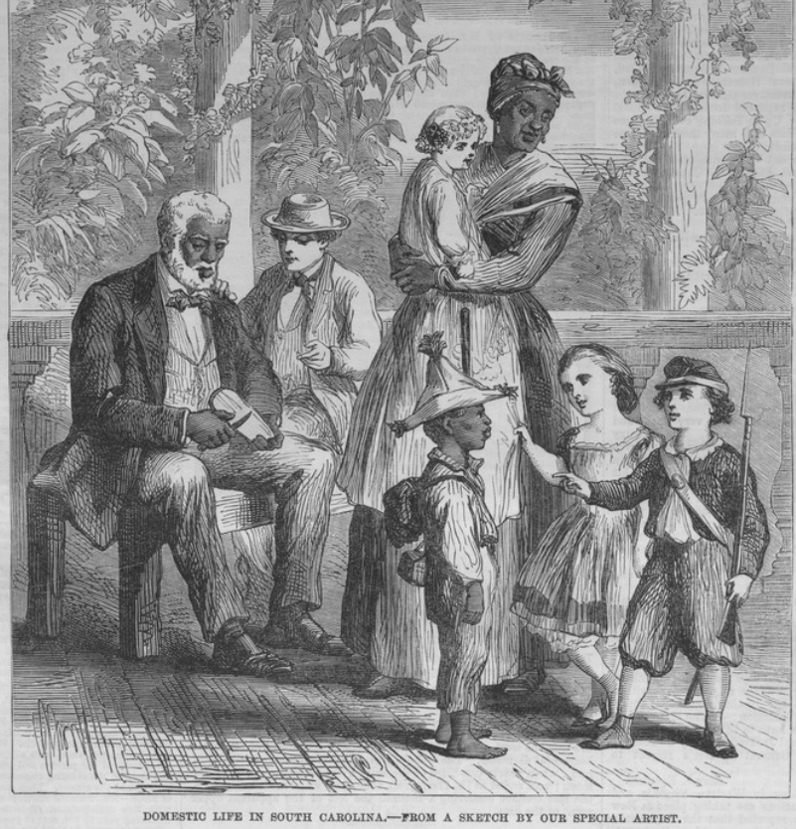
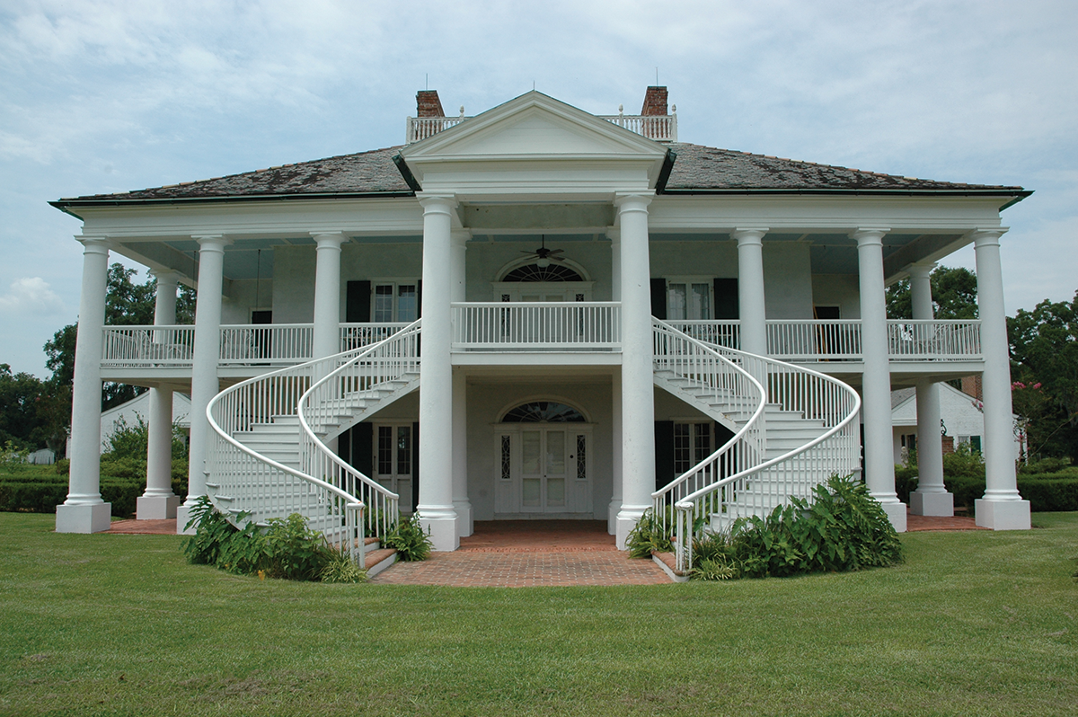
Discuss
What might someone who was forced to work in the house have had to worry about?
Courtesy of the New York Public Library, b17149519.
Roberto Michel/Shutterstock.com

Slide 8
Set Up Your Notes
Fieldwork
Housework
Notes:
Teachers get 2 min

Slide 9
Read for General Comprehension
On your T-chart, take notes and answer the following questions:
What was daily work like?
What worries did people experience both in and out of the house?
What other general information did you learn about the kind of work done in the field and in the house?
Notes:
Teachers get 2 min

Slide 10
Turn and Talk
How might someone who worked inside the house help someone who worked in the field?
How might someone who worked in the field help someone who worked in the house?
Why do you think there is so much focus on the division between fieldwork and housework?
What stereotypes exist about who stayed in the “Big House?”

Slide 11
Problematize Myths, Assumptions, and Stereotypes
We are going to use video clips to discuss:
What are additional stereotypes do you notice?
What are some aspects of plantation life, or life in a labor camp, that complicate the relationship between the enslaved and their enslaver?

Slide 12
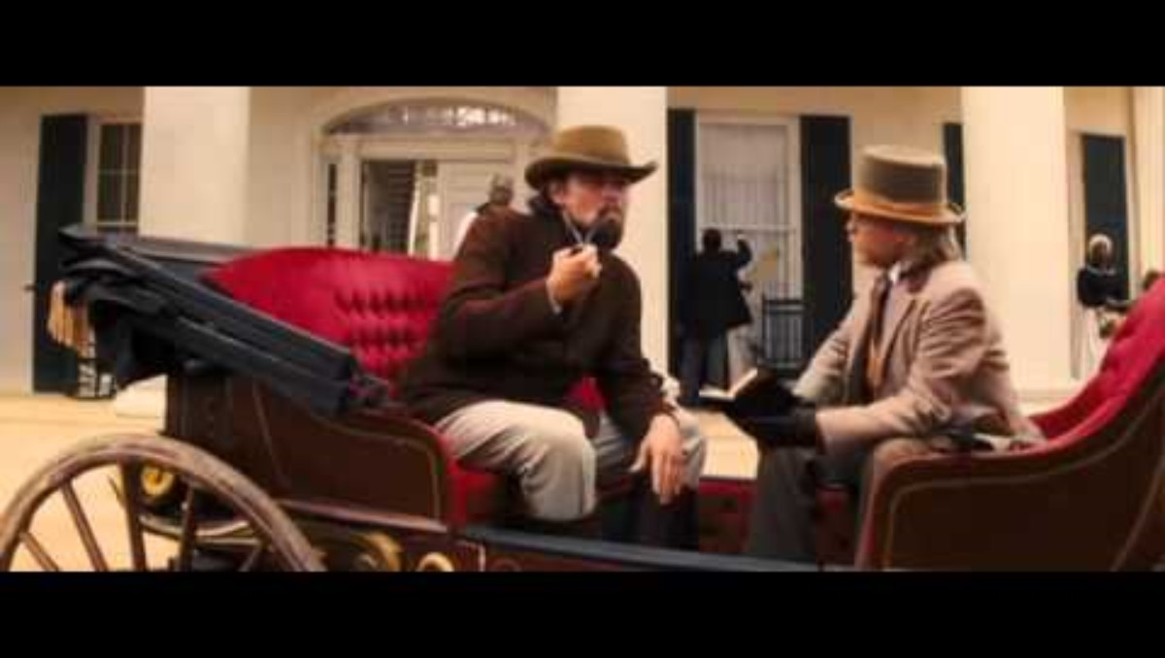
Django Unchained
Notes:
Follow up by asking students:
What stereotypical character does Samuel Jackson play?
Why is he so appalled with a Black person staying in the “Big House?”
Were all people who worked in the house lighter skinned?
Why do you think these stereotypes exist?

Slide 13
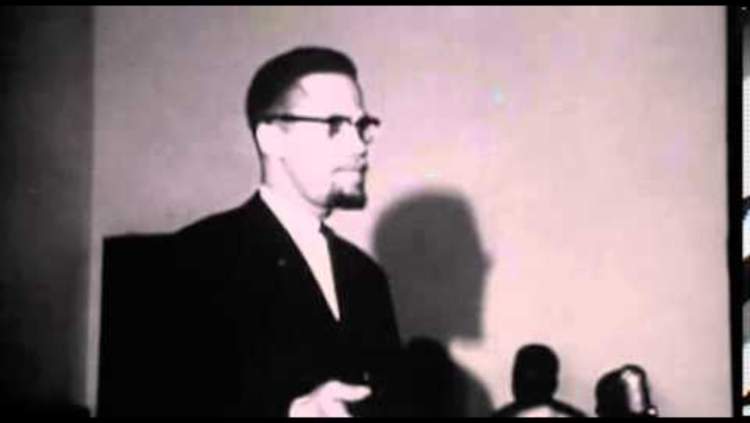
Malcolm X “Field vs. House” Negro
Notes:
Follow up by asking students:
Follow Up Discussion Questions:
What does Malcolm X say that the field negro wants to happen to master and his house?
What does Malcolm X say that the house negro wants to happen to the master and his house?
Optional - have students read the speech rather than watch the video

Slide 14
Exit Ticket
Why is there so much complexity in the history of fieldwork vs. housework?
Do you agree with Malcolm X’s assertion about the “field” and “house” negro? Why or why not?
In your response: cite evidence from one source you engaged with during class today.

